Slide 1
Pooling Strategies for Integrated Data Analysis:
SDTM or ADaM Level Pooling?
Anagha Bhatkhande
20-Jan-2018
ISCR

Slide 2
Agenda
What is Safety Review?
About ISS/ISE
Contents of ISS/ISE
Summary of Clinical Safety and Efficacy – the difference
eCTD Triangle- Where do we fit in?
Pooling strategies –SDTM or ADaM
Process Flow: ISS or ISE Programming
Planning for Pooling
Recommendations
Insert Program Date
Insert Program Title

Slide 3
What is Safety Review
“Safety Evaluation” continues throughout development lifecycle of a drug and later on post-marketing as well.
Assessment of Safety means to ascertain Benefits of drug outweigh the Risk.
The Health Authority review process involves assessing for efficacy and safety of a marketing application and consider benefit and risk.
There are several measures within a clinical submission dossier to assess adequacy of safety data, these include:
  Integrated summary of safety and efficacy
  Summary of clinical safety and efficacy
  Risk management plan
  Periodic safety reports (DSUR, PSUR, PBRER, ASR, IB, Orphan Designation Annual Report)
  90 / 120 day Safety Update

Slide 4
About ISS/ISE
Critical components of the clinical efficacy and safety of a marketing or licensing application
Requirement by FDA and other HAs to provide this summary in the NDA (As per 21 CFR 314.50(d)(5)(v) and 21 CFR 314.50(d)(5)(vi)(a), respectively)
Not summaries, detailed integrated analyses of all relevant data from the clinical study reports
Consolidated review of the drug profile to identify the benefit/risk ratio
The integrated data supports subgroup analysis or identifying rare data trends thus making the application robust
The pooled data substantiates the observed versus expected results enabling and easing the decision making process
Insert Program Date
Insert Program Title
Notes:
Speaker notes:
The primary reason to create Integrated summary is combine various study data and to arrive at a consolidated review of the drug profile to identify the benefit/risk ratio.
The pooled data contains information of safety volunteers to study patients and helps the reviewers get a clarity of data trends and exploring the integrated data
The pooled data substantiates the observed versus expected results enabling and easing the decision making process.
The integrated data supports subgroup analysis or identifying rare data trends thus making the application robust
It is one of the requirements by FDA and other HAs to provide this summary in the NDA

Slide 5
Contents of ISS/ISE
ISS - Integrated Summary of Safety contains the following details:
  Clinical trial data, collected form a healthy volunteers (from phase 1 study) and patients (all other studies).
  Exposure of drug by the patient
  Baseline / Demographic characteristics of patients enrolled in the study
  Listing the deaths occurred -during the study
  Drop-out patients from the study
  Potential SAE, other AEs of clinical significance, toxicity grading
  Lab results, Liver function test, Renal function test
ISE - Integrated Summary of Effectiveness contains the following details:
  Mostly clinical trial data from phase II, phase III and phase IV studies and not of phase I.
  Summary of the efficacy data along with baseline / demographic characteristics impacting the efficacy results.
Insert Program Date
Insert Program Title
Notes:
ISE may not be always required. It depends on the objective of the integration.
Need of ISE would be only if there are a lot of Efficacy and Effectiveness studies conducted with the same objective with different population / subgroup criteria
Other the SCE is generally sufficient for an effective submission.
Again to integrate for efficacy we would need identical study designs so that we can have meaningful summaries from the data.

Slide 6
Summary of Clinical Safety and Efficacy
CTD Module 2 : Clinical overview (Summary of clinical efficacy and safety)
Differs with ISS/ISE in the depth of the analyses and the amount of information
The SCS (and the SCE by inference) should be a summary of the full integrated analyses of safety (and efficacy) that are routinely submitted in some regions (i.e., the ISS and ISE in the US)
The SCS and SCE should be the summary of the detailed ISS and ISE and focus on the key analyses which would be the part of the drug label
Notes:
AS a part of the CTD in Module 2, the US FDA requires Clinical overview which comprises of Summary of clinical efficacy and safety.
The core difference between the ISE/ISS and their corresponding clinical summaries is in the depth of the analyses and the amount of information needed to support the analyses.
While documenting the larger integrated analyses of efficacy and safety in the ISE and ISS, applicants should develop a strategy and process for deriving the SCE and SCS.
The SCS (and the SCE by inference) should be a summary of the full integrated analyses of safety (and efficacy) that are routinely submitted in some regions (i.e., the ISS and ISE in the US).
The SCS and SCE should be the summary of the detailed ISS and ISE as a part of the clinical overview and should focus on the key analyses which establish the robustness and effectiveness of the drug which would be the part of the drug label

Slide 7
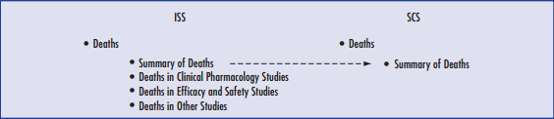
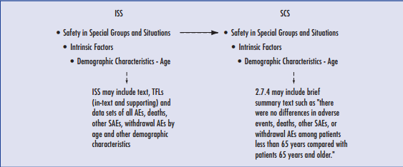
Sample transition from ISS to SCS

Slide 8
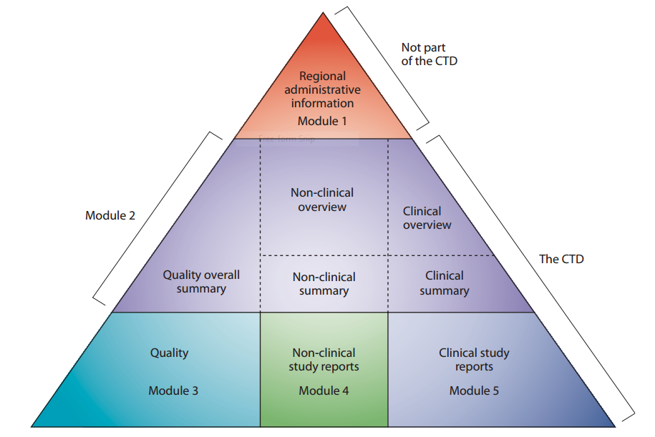
eCTD Triangle
Documents for submission
The common Technical Document
The CTD is organized into five modules.
Module 1 is region specific
Modules 2, 3, 4 and 5 are intended to be common for all regions.
In July 2003, the CTD became the mandatory format for new drug applications in the EU and Japan, and the strongly recommended format of choice for NDAs submitted to the FDA.
Insert Program Date
Insert Program Title
Notes:
The CTD is organised into five modules. Module 1 is region specific and Modules 2, 3, 4 and 5 are intended to be common for all regions. In July 2003, the CTD became the mandatory format for new drug applications in the EU and Japan, and the strongly recommended format of choice for NDAs submitted to the FDA.

Slide 9
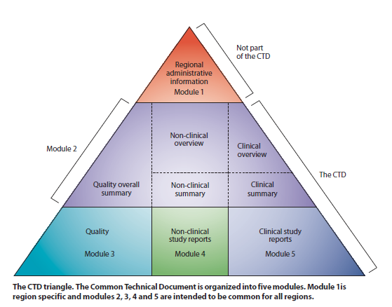
eCTD Triangle
CTD Section | U.S.Regulation | Comment
2.5 Clinical Overview (Approx. 30 pages) 2.5.4 Overview of Efficacy 2.5.5 Overview of Safety | N/A | Not a U.S. Requirement, but recommended by ICH M4E
2.7 Clinical Summary (Approx 50-400 pages) 2.7.3 Summary of Clinical Efficacy 2.7.4 Summary of Clinical Safety | 21 CFR 314.50 (c) (2) (viii) | U.S requirement for a clinical summary
5.3 Clinical Study Reports 5.3.5.3 Reports of Analyses of data from More than One study (Including any formal integrated analyses, Meta Analyses, Bridging Analyses) | 21 CFR 314.50 (d) (5) (v) 21 CFR 314.50 (d) (5) (vi) | Integrated Summary of Effectiveness Integrated Summary of Safety
Insert Program Date
Insert Program Title

Slide 10
Process Flow: ISS or ISE Programming
Pooling Strategy: SDTM or ADaM?
Raw data
Study 1, 2,3……n
Convert Raw data to CDISC SDTM standard data
Study 1, 2,3……n
Approach 1
Approach 2
SDTM 1
SDTM 2
SDTM 3
SDTM n
SDTM 1
SDTM 2
SDTM 3
SDTM n
Integrated SDTM datasets
ADaM 1
ADaM 2
ADaM 3
ADaM n
Integrated ADaM datasets
Integrated ADaM datasets
Notes:
Speaker notes:
Legacy or long term project mapping of SDTM datasets would be preferred:
With the two different CDISC standards, there are two ways to integrate the data for analysis
SDTM Pooling:-
Easy to up versioning of dictionaries like MedDRA, WHO , Grading using CTCAE criteria etc
Tracking data issues is easy
May need more time programmatically to build integrated SDTM database.
Need to keep track of changes to data , if the studies are ongoing at the time of pooling
(2) ADaM Pooling:-
The main advantage of this approach is that it may take less time than the first approach.
May need to wait till individual studies ADaM datasets are available and stable.
Navigating and searching source SDTM datasets may not be that easy.
Programmer may need to spend more time to understand analysis dataset specifications from individual studies.

Slide 11
Advantages and Disadvantages
Factors | SDTM Pooling | ADaM Pooling
Data Standards | No special requirements, Best to use same raw data standards | Best to have standards for the data, the metadata, the codelists and the derivations.
Time and Resources | Limited time and resources are needed | More time and resources needed for legacy studies
Traceability to single study data | Easy to trace back from integrated ADaM | Challenging for Legacy studies
Traceability to single analysis | Difficult to have traceability from the integrated database back to the single study results, if different algorithms were used for derivations. | Differences between single study and integrated analysis are easy to identify.
Harmonization of algorithms | no harmonization is needed as the integrated ADaM panels are directly created out of SDTM. | In the case that there were different derivation algorithms used in the single studies, there is a need to harmonize these algorithms
Insert Program Date
Insert Program Title

Slide 12
Planning for Pooling
Data Standards (CDISC or Legacy?)
Number of studies and datasets for submission
Consistency in Versions:-
    SDTM/ADaM versions
    OpenCDISC for Conformance Checks
    Controlled Terminology
    Dictionaries like MedDRA, WHO
    CTCAE criteria
Consistency is data derivations:-
    Baseline period
    Follow-up period
    How is missing data handled?
    Date imputation
    Laboratory data conversions
    Efficacy derivation (implementing PD/PV for per-protocol population)
    Statistical methodology (if applicable)
    Population Flags…
Insert Program Date
Insert Program Title
Notes:
Have a master analysis plan with a clear definition of the pooling requirement and the studies to be pooled identified.
Identify all the possible inconsistencies that can happen from study to study:
Baseline period
Follow-up period
How is missing data handled
Date imputation

Slide 13
Planning for Pooling (contd…)
Data Consistency among studies:-
    Checking Attributes – PROC CONTENTS
    SDTM Mapping
    Domain check
    Formats/Controlled terminologies
    Laboratory data conversions
ADaM level checks:-
    Dates
    Units
    Baseline Flags
    AE coding and missing data
    Formats/Controlled terminologies
    Laboratory data conversions
Insert Program Date
Insert Program Title

Slide 14
Recommendations
Setup a master plan document including the following:
  Specify derivation for Project
  Define study specific derivations
  Define data handling plan
  Include CRF harmonization
  Define consistency checks
  Include a detailed project plan
    Identify the team roles and responsibilities
    Define RASCI
    Define a TAT for every activity and role
    Identify Parent and Child protocol for seamless integration
    Team roles
Insert Program Date
Insert Program Title
Notes:
Specific derivation for Project: Rules for all derived variables such as RFSTDTC, RFENDTC, RFPENDTC, --DY, --BLFL, etc.
Check and plan specs, formatting, date handling, splitting long text, length calculation, SUPPQUAL handling, data output, XPT conversion, generating derived variables, consistency checks across panels within protocol and across protocols.
Some data interpretation such as mapping original term to standard CT when CRF wording different from standard CT.
Dividing development team work on same type of domains and validation team work by protocols
Divide teams working on domains by SDTM class (Special purpose, Event, Finding, Intervention and Trial design)
Consistency checks across panels within protocol and across protocols
Teams for different domains and each team is responsible for assigned domains for all the studies.
Core team – each core team will have deep understanding of the protocol and CSR of a study and maintain the integrity and consistency within the study.
Issue log by batches – all issues are tracked for resolution status
Speaker note for Team roles:
Core team – each core team will have deep understanding of the protocol and CSR of a study and maintain the integrity and consistency within the study.
Dividing development team work on same type of domains and validation team work by protocols
Divide teams working on domains by SDTM class (Special purpose, Event, Finding, Intervention and Trial design)
Consistency checks across panels within protocol and across protocols
Teams for different domains and each team is responsible for assigned domains for all the studies.

Slide 15
Recommendations
Setup a master plan document including the following:
  Master specification:
    Datasets in different sheets
    Variable list with attributes (label, length, type, etc.)
    Required or permissible variables (defined in a column)
    Common variables
    General derivation rules or study specific (explicit description)
    Variable list with study matrix
    Consistency checking
    Utility programs to create individual study specification
Insert Program Date
Insert Program Title
Notes:
Specific derivation for Project: Rules for all derived variables such as RFSTDTC, RFENDTC, RFPENDTC, --DY, --BLFL, etc.
Check and plan specs, formatting, date handling, splitting long text, length calculation, SUPPQUAL handling, data output, XPT conversion, generating derived variables, consistency checks across panels within protocol and across protocols.
Some data interpretation such as mapping original term to standard CT when CRF wording different from standard CT.
Dividing development team work on same type of domains and validation team work by protocols
Divide teams working on domains by SDTM class (Special purpose, Event, Finding, Intervention and Trial design)
Consistency checks across panels within protocol and across protocols
Teams for different domains and each team is responsible for assigned domains for all the studies.
Core team – each core team will have deep understanding of the protocol and CSR of a study and maintain the integrity and consistency within the study.
Issue log by batches – all issues are tracked for resolution status
Speaker note for Team roles:
Core team – each core team will have deep understanding of the protocol and CSR of a study and maintain the integrity and consistency within the study.
Dividing development team work on same type of domains and validation team work by protocols
Divide teams working on domains by SDTM class (Special purpose, Event, Finding, Intervention and Trial design)
Consistency checks across panels within protocol and across protocols
Teams for different domains and each team is responsible for assigned domains for all the studies.

Slide 16
Recommendations
Setup a master plan document including the following:
  Efficacy data structure and general derivation rule document including:
    Key analysis variables/parameters definition
    Traceability variables (XXSEQ, SRCSEQ, SRCDOM, RELCRIT, RELFACT) definition
    Specific examples for possible scenarios
    Special data handling rules
    Programming standard and validation
  CSR result verification:
    Key variables to verify: Population Flags, Adverse Event, Efficacy parameters
    Figuring out reasons for discrepancies: Data handling rules, methods of analysis
    Solution for reconciliation: Team discussions and decisions
    Documentation of decisions made
Insert Program Date
Insert Program Title
Notes:
Efficacy data structure and general derivation rule document helped programmers to create consistent analysis datasets across studies

Slide 17
THANK YOU
Insert Program Date
Insert Program Title

